Slide 1
Physics Problem Solving
Mar. 18th Mon 12:40
Physics Lab P2
Dara Daneshvar
Eason Shao

Slide 2
Today
(Continuing) Fun Questions!
@13:15, Room 216 (Math Soc)
Some Insights into Quantum Field Theory & Symmetries by Carlos Barredo

Slide 3
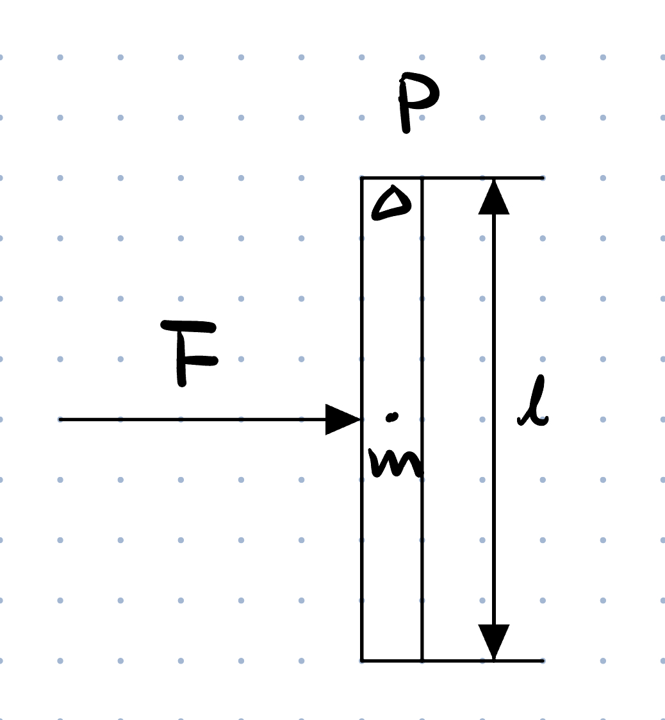
Qu. 5 (Reference Frame, Rotational Mech.)
Imagine if we have a uniform stick of mass m and length l in void space, initially at rest. We apply a force F, perpendicular to the stick, at the centre of the stick. It is not difficult to realise that it accelerates along the line of action of the force, without rotating. However, if we choose one end of the stick to be the pivot, the resultant moment seems to be not zero. Can you explain why?

Slide 4
Qu. 5
Key Takeaways
Be careful about inertial frames and non-inertial frames
D’Almbert’s Principle on Inertial Forces: one can transform an accelerating rigid body into an equivalent static system by adding the so-called inertial force which must act through the centre of mass
Remember that inertial force also contributes moments!
An interesting story (ES)

Slide 5
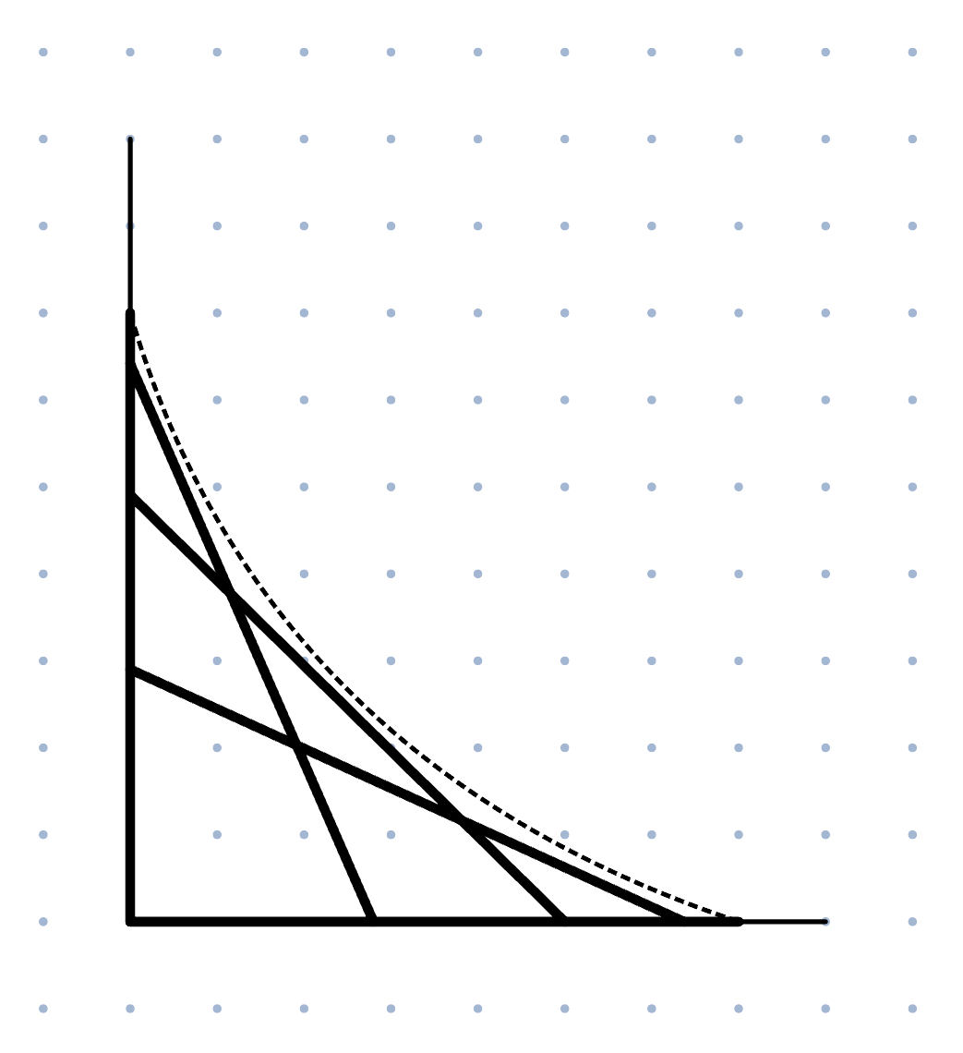
Qu. 2 (Mathematical Methods)
A ladder initially sits against a vertical wall. When it slides down (with its top end touching the wall, and bottom end touching the floor), what is the equation of the envelope formed by the ladder's positions?

Slide 6

Qu. 2 (Mathematical Methods)
Desmos:
https://www.desmos.com/calculator/indjrccnam

Slide 7
Sources of Questions
Questions we made (people probably made them before us):
Qu. 2: ES
Qu. 5: LS
Diagrams: Originality Claimed (ES)

Slide 8
Some More
Question Set for Easter Holidays?
After Easter: Topic-Focused Sessions, with official BPhO Topic-Based Question Set
Feedback Form & Question Submission form are on Google Classroom.

